Slide 1
FPS Beginning Coaches Training
Part 3:
The Criteria and Table
The Action Plan
April 2020

Slide 2
Steps 4 & 5: The Criteria and the Table

Slide 3
Selecting your Best Solutions
After completing your 16 solutions, the team members select the eight solutions that they feel are most likely to solve the UP
These are written in the table using only a short description of the solution

Slide 4
Criteria
The criteria are used to measure the effectiveness of your top eight solutions
Each criteria must include a superlative adjective
Each needs to be correctly written as a question

Slide 5
Criteria
Applicability and Relevance
Criteria not correctly written ARE evaluated for relevance and applicability.
A well-written criteria should be relevant
A criteria could be classified as not relevant if it would have no impact while evaluating the solutions

Slide 6
2 Tier Criteria
Generic (1 point)
Definition: A criterion that can be linked or used with any topic of study.
Examples:
Which solution will be the most effective?
Which solution will cost the least?
Which solution will make the most people happy?

Slide 7
2 Tier Criteria
Advanced (2 points)
Definition: Criteria that go beyond generic.
Advanced criteria can be written in three ways:
Based on the KVP, condition phrase or the purpose of the UP.
Specific to the topic that cannot be easily used with many other topic areas.
A generic core idea that is justified with specific, detailed information from the Future Scene.

Slide 8
2 Tier Criteria
Examples of 2-point criteria using the following UP:
AI-driven aircars are a popular alternative to traditional automobiles at airports in 2061, adding to the further congestion of the skies already full of short-haul and long-haul aircraft. How might we alleviate congestion at airports worldwide so that the potential for air accidents is lessened.
(UP/KVP) WSW alleviate the most congestion at airports worldwide?
(UP/Purpose) WSW reduce accidents the most at airports worldwide?
(Generic + FS Fact) Since aircars are driven by AI navigation systems, WSW be the safest in case AI fails?
(Plain, specific) WSW protect the security of air travelers the most?

Slide 9
2 Tier Criteria
2-point criteria using the following UP:
AI-driven aircars are a popular alternative to traditional automobiles at airports in 2061, adding to the further congestion of the skies already full of short-haul and long-haul aircraft. How might we alleviate congestion at airports worldwide so that the potential for air accidents is lessened.
(Generic + FS Fact) Since business travelers are sometimes subjected to hand searching of carry-on bags, WSW save the most time for these travelers?
(Plain, specific) WSW create the most equity for travelers of all income levels?
(Plain, specific) WSW best protect the privacy of air travelers? (This criterion may be classified as not relevant depending on the Future Scene)

Slide 10
Apply Criteria to Solution Ideas in the Table
The evaluators are looking for eight solutions that they expect to be relevant to the UP.
Each solution is ranked from 1-8 based on each criterion.
List the solution with a very brief description in the table
Total score on the Table = 180 points

Slide 11
Example Table
 | Criterion 1 | Criterion 2 | Criterion 3 | Criterion 4 | Criterion 5 | Total
Solution 4 | 1 | 2 | 2 | 3 | 1 | 9
Solution 7 | 4 | 5 | 3 | 2 | 6 | 20
Solution 8 | 7 | 4 | 6 | 8 | 8 | 33
Solution 10 | 5 | 3 | 1 | 1 | 2 | 12
Solution 11 | 8 | 6 | 4 | 7 | 7 | 32
Solution 13 | 2 | 7 | 8 | 5 | 4 | 26
Solution 15 | 6 | 8 | 5 | 4 | 5 | 28
Solution 16 | 3 | 1 | 7 | 6 | 3 | 20
Solution #8 would be used to create the team’s Action Plan as it scored the highest total score.

Slide 12
Applying Criteria to Solution Ideas
Evaluators are looking for correct use of the table
Each error is assessed a one point penalty
An automatic score of 1 is given if the incorrect solution is used to write the Action Plan

Slide 13
Alumni Affirmation
The techniques of FPS are similar to the techniques of the scientific method, so I felt I had a jump-start on my studies.
Arthur Mandelin
Northwestern University Feinberg School of Medicine: Assistant professor of medicine and practicing physician

Slide 14
Step 6: The Action Plan

Slide 15
Action Plan
An action plan is a proposal for solving the UP.
Explain in detail the who, what, why, how, when and where of the solution idea.
It should be a workable idea
It should have an impact on the Future Scene
It should include new pathways and details
Combining UNRELATED solution ideas are scored lower

Slide 16
Development of the Action Plan
This measures the degree to which the team describes its Action Plan.
How and why will the solution idea solve the underlying problem?
What will be done?
Who will implement the plan?
What is the timeline for implementation?
What are the beneficial results?
What is the plan for paying for implementation?
Did the team consider possible problems?
Has the team included all the affected stakeholders?

Slide 17
Scoring of the Action Plan
A score of “1” will be given on relevance, effectiveness and impact for action plans that are completely off target relative to the UP or the Future Scene.
Relevance
Effectiveness
Positive Impact
Humaneness
Criteria in development of Action Plan (new)

Slide 18
Alumni Affirmation
I think that the biggest impact FPS had on my education was encouraging curiosity. FPS pushed my young mind to integrate knowledge into creative solutions. I felt that I was more prepared for education at the collegiate level than many of my peers, mainly because I had already learned how to think critically through my experiences in FPS.
Abigail Zellner
UW-Madison: Neurobiology; Human Development & Family Studies
Wisconsin FPS

Slide 19
Questions or Comments
If you have questions about the Washington Future Problem Solving Program, please email the Affiliate Director at jbuissinkwafps@gmail.com
Check out the wafps.org website for more information.

Slide 20
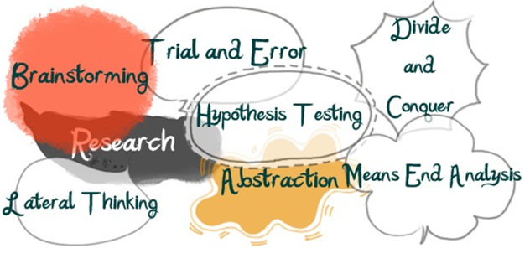
The End

