Slide 1
FPS Beginning Coaches Training
Part 2:
The Underlying Problem
Writing Solutions
April 2020

Slide 2

Topics for 2020-21
Problem #1 Water Supply
Problem #2 Building Green
QP: Insects
SB Mining
IC: Announcement March 1, 2022

Slide 3
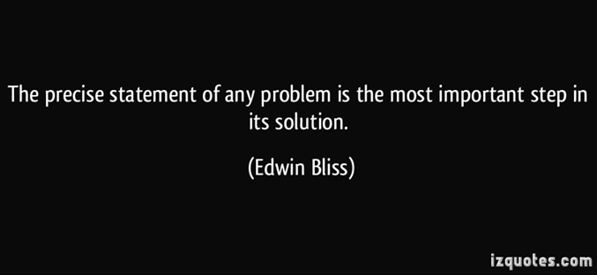
Step 2: The Underlying Problem (UP)

Slide 4
Underlying Problem (also known as the UP)
A UP is stated as one question containing four basic components
The condition phrase
The stem + KVP
The purpose
The future scene parameters
The completeness scores simply determines if “all the parts are there.”
Notes:
MUP? DO you mean “UP”?

Slide 5
Underlying Problem
Condition Phrase
It is taken directly from Future Scene
It provides a reason or a cause
The condition phrase usually begin with “Because”

Slide 6
Underlying Problem
Stem + Key Verb Phrase
“How might we “ or “In what ways might we”
One action verb or phrase
All the solutions are derived from the KVP
The KVP needs to be relevant to the Future Scene

Slide 7
Underlying Problem
Purpose
Reason
Most purposes start with the words “so that ...”

Slide 8
Underlying Problem
The UP must contain all three Future Scene Parameters
    Topic (Food Distribution)
    Time (2065)
    Place (coastlines of Africa and South America or the World)

Slide 9
Underlying Problem
Example UP for Food Distribution:
Because genetically-modified fish eggs grow into faster-maturing, higher-protein fish, how might we increase the probability that these super fish will continue to provide a edible food source so that the Poseidon Corporation can continue to distribute food to the impoverished countries of Africa and South America in 2065 and beyond?

Slide 10
Underlying Problem
Focus and Adequacy:
It should be a significant sub-problem of the Future Scene
Try not to make assumptions that are not inferred or stated in the Future Scene
High quality UP’s should have a POSITIVE impact
State your KVP in a positive rather than a negative fashion. (Ex: increase rather than reduce, improve rather than impair)

Slide 11
Alumni Affirmation
The cliche is that FPS taught me "how to think, not what to think," but I think that's true—I learned so much about the process of defining and solving problems that I've used since I learned about conflict and compromise and negotiating the dynamics of a group of very strong-willed, often stubborn teammates under intense pressure. All of these are skills I've drawn on in college and in my life since.
Reuben Henriques
Brown University: Political Science
High School History Teacher, Kipp Academy

Slide 12

Step 3: Solutions

Slide 13
The Category List
(used for challenges and solutions)
1. Arts & Aesthetics 10. Government & Politics
2. Basic Needs 11. Law & Justice
3. Business & Commerce 12. Miscellaneous
4. Communication 13. Physical Health
5. Defense 14. Psychological Health
6. Economics 15. Recreation
7. Education 16. Social Relationships
8. Environment 17. Technology
9. Ethics & Religion 18. Transportation

Slide 14
Solutions
Solution ideas should be written in statement form as definite proposals.
They should be Relevant
Must not contradict the FS
They do not have to quote from the UP

Slide 15
Solutions
A solution may partially solve the UP
Solutions do not have to work perfectly—they just need a likelihood of success
They must be humane
They should be new ideas
They should be written as complete sentences

Slide 16
Solutions
Teams should elaborate each solution idea.
Who will be responsible for putting this solution into practice
What will they actually be doing in the solution
How or why will they accomplish their plan
(Optional) When and where will the solution happen
For a solution to be counted as an elaborated solution, it needs to include three of the four—who, what, why or how.

Slide 17
Practice Writing Solutions
Assignment: Using the Food Distribution UP (Slide #8), write three solutions of your own that you think will solve the UP.
Example solution 1: By diversifying the types of genetically-modified fish eggs, the World Ecology Corporation will increase the diversity of fish reducing the probability of mass extinction of the fish being caught by the Poseidon Corporation.
Example solution 2: The United World Conservation Corporation will create a world fish gene bank that will be used to create a greater fish gene pool so that many different types of fish will be more likely to survive if there is a global fish pandemic.

Slide 18
Alumni Affirmation
Participating in FPS has had and continues to have a profound impact on my education, career, plans for the future, and interpersonal relationships. Most notably, I learned to see undesirable and/or unforeseen circumstances as solvable challenges rather than unsurmountable problems. This mindset has encouraged me to pursue experiences that were outside of my comfort zone and to take on responsibilities that required me to quickly acquire additional skills.
Danielle Breidung
Washington and Lee University: Sociology, Anthropology, Poverty and Human Capability Studies
AmeriCorps Vista at University of South Carolina, Program Coordinator for 55 VITA volunteers (Volunteer Income Tax Assistance)

Slide 19
THIS CONCLUDES PART 2 OF THE TRAINING
If you have questions, please email jbuissinkwafps@gmail.com
CHECK OUT THE wafps.org WEBSITE FOR MORE INFORMATION

